Slide 1
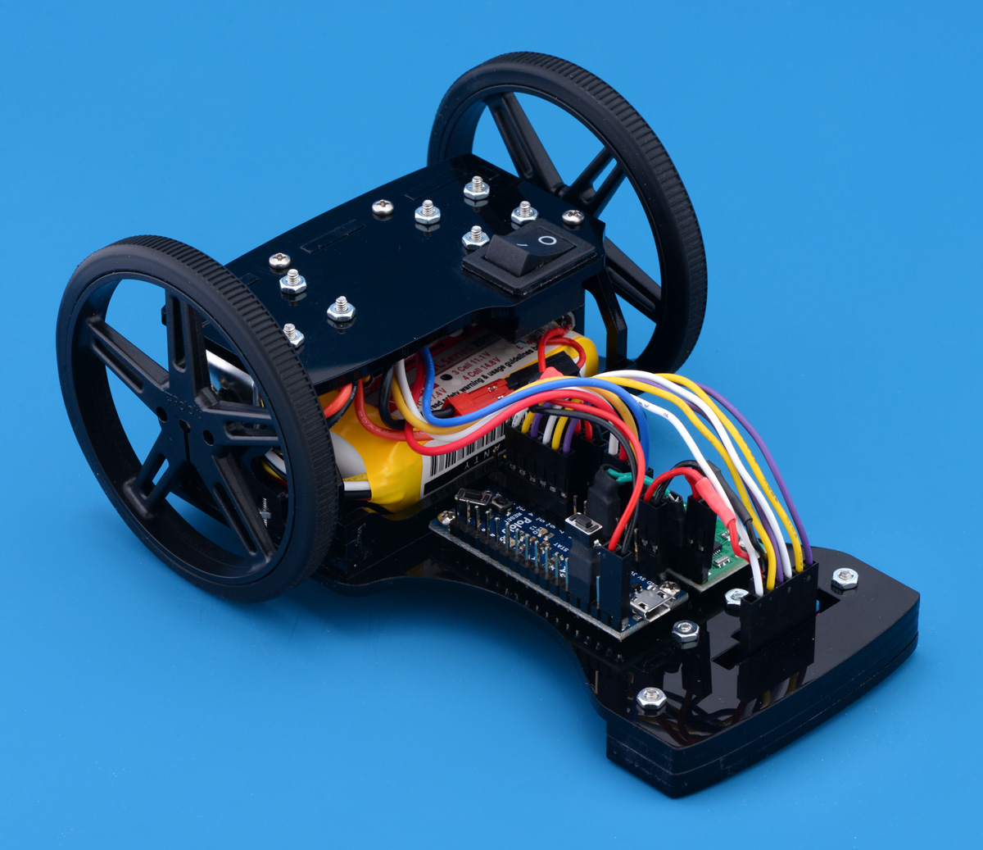

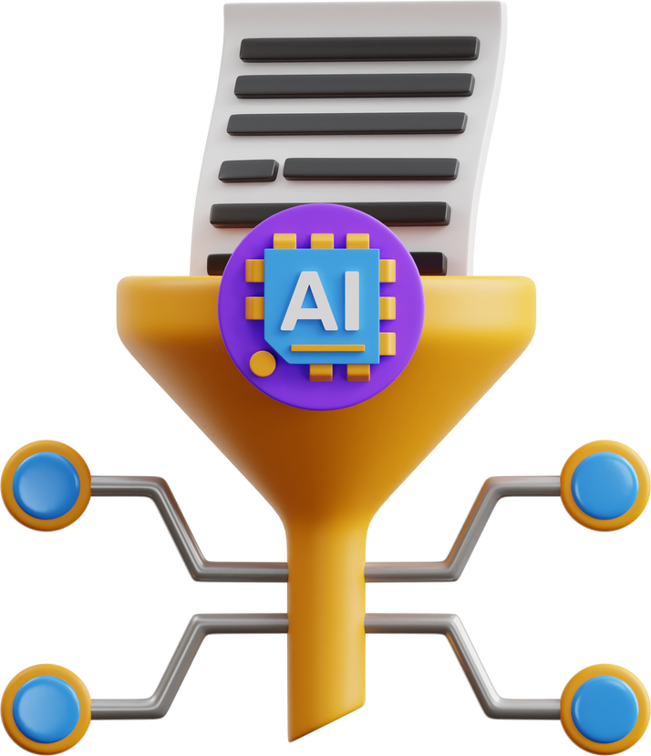
Our 6-Day Bootcamp Journey
Team 10 Minutes
Learning, Fun & Innovation.

Slide 2
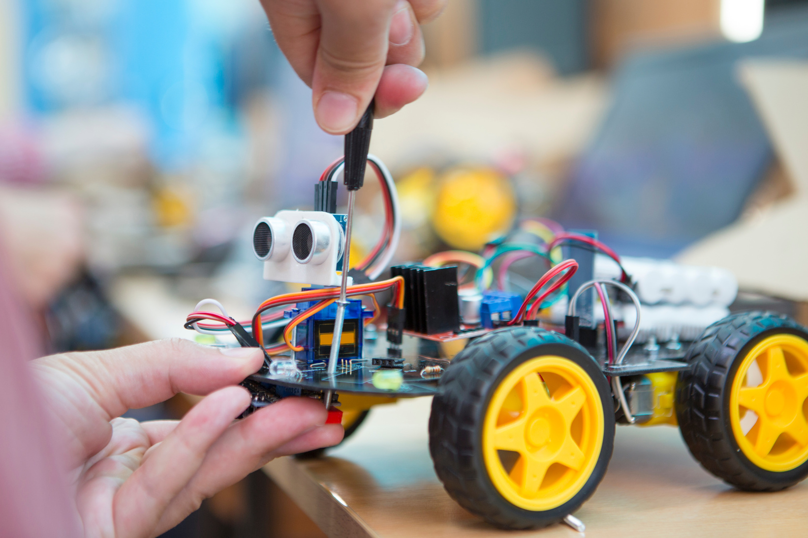
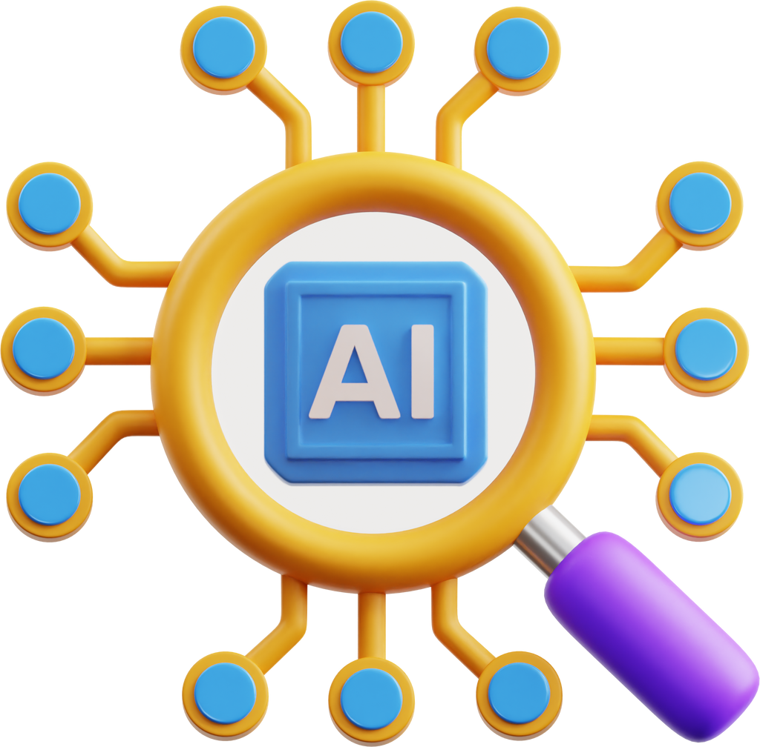
Introduction
The bootcamp was a 6-day hands-on learning journey.
Learned from basic electronics to building & programming bots.
Activities, quizzes, races & presentations made it fun and competitive.
Gained both technical skills and teamwork experience.

Slide 3

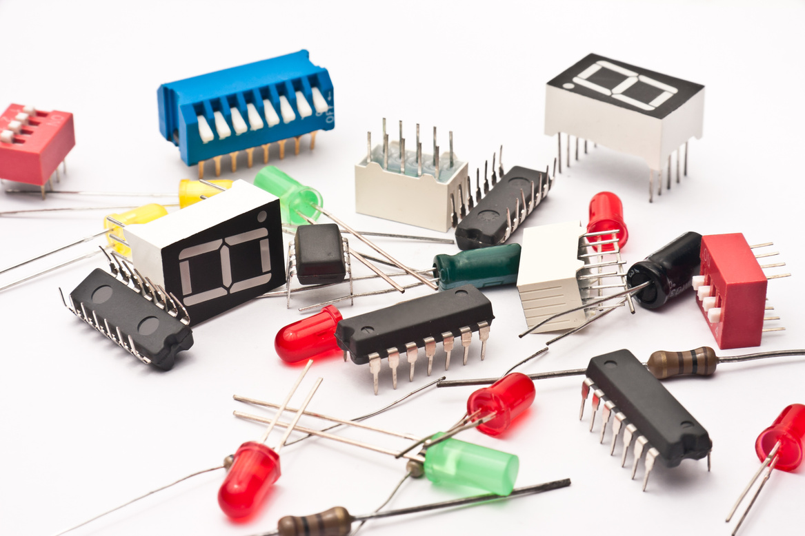
Building the Foundation
What we Learned :
Core concepts of Voltage, Current, and Resistance.
Identification and function of basic components.
Understanding basic circuits.

Slide 4
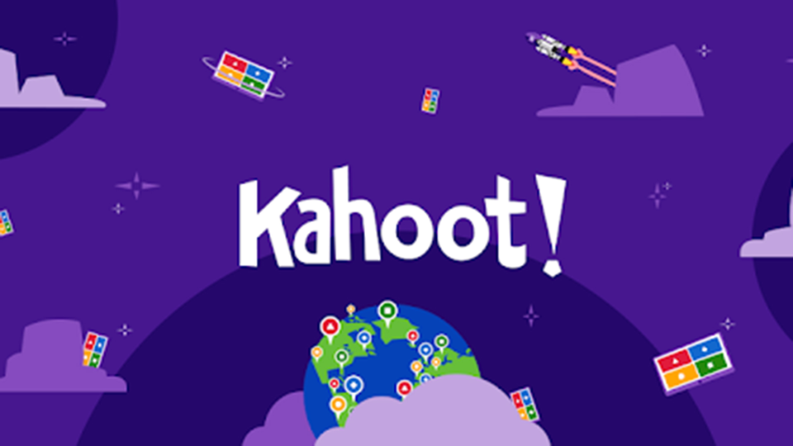
Building the Foundation
Activities & Highlights:
Engaging hands-on activities to grasp concepts.
Interactive Kahoot Quiz to test our knowledge.
Presentation: "Fast Competitive PID Line-Following Robot Component Selection & System Design" – setting the stage for what was to come!

Slide 5

Day
2
Understanding the Robot's Core 🤖
What We Learned:
Deep dive into how robots move and perceive their environment.
Actuators: Motors (DC, servo), their function, and control.
Sensors: Understanding different types (IR, ultrasonic) and their applications in robotics.

Slide 6
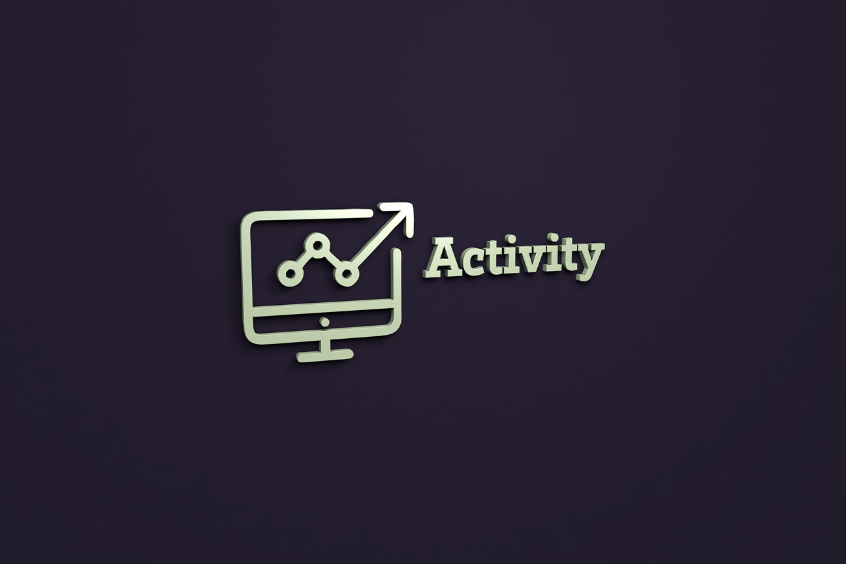
Day
2
Understanding the Robot's Core 🤖
Activities & Highlights:
More interactive sessions to see these components in action.
Another exciting Kahoot Quiz!
"Pick and Speech" challenge: Fostering quick thinking and presentation skills.

Slide 7

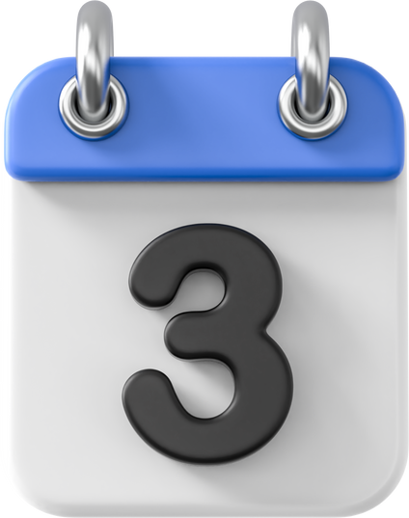
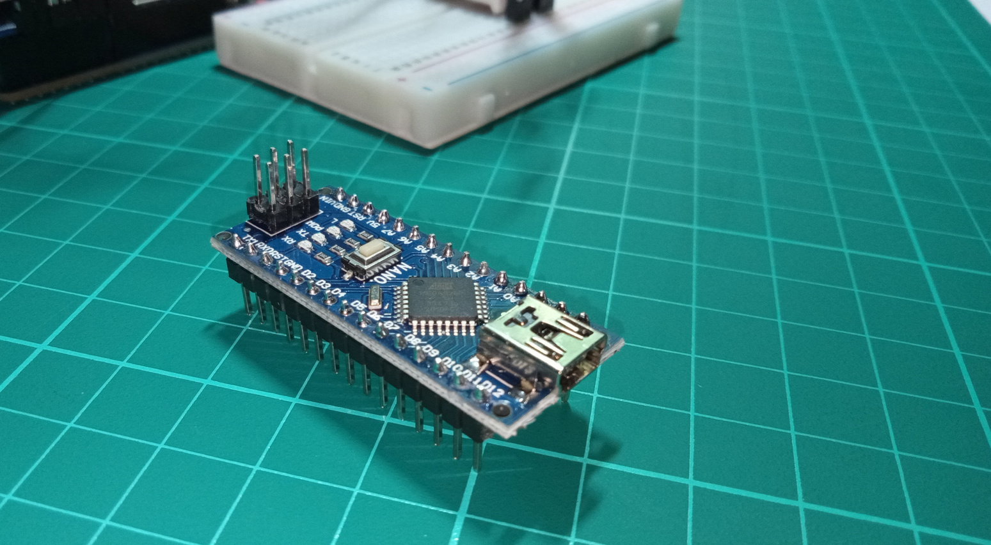

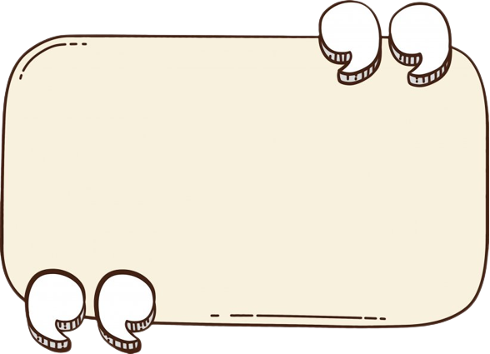

Day
Our First Steps with Arduino Nano
What we Learned
How to set up the Arduino Nano and its environment.
Uploading code and debugging simple programs.
Learned coding basics & hardware connection.

Slide 8
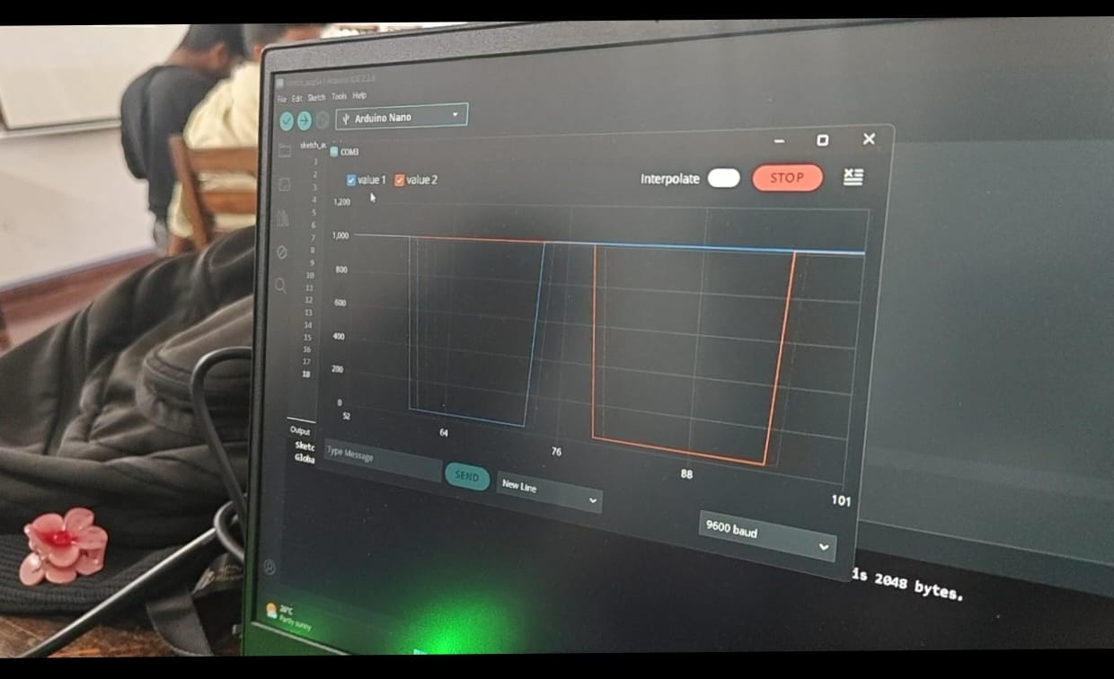

Day
Activities & Highlights
Uploading a simple code to the Arduino Nano.
Sending output video of our successful activity to the WhatsApp group – a real-time showcase of our progress!
Fun and engaging — enjoyed hands-on work.

Slide 9


Day
Building & Racing Our Bots! 🏁
What we Learned
The full assembly process of a line-following robot.
The critical importance of iterative testing.
Calibrating sensors for optimal performance.

Slide 10
Day
Activities & Highlights:
🔧Built our line-following bots from scratch.
🏁The Bot Race! A thrilling and practical competition.
🛠️Spent hours testing and perfecting our bots.

Slide 11


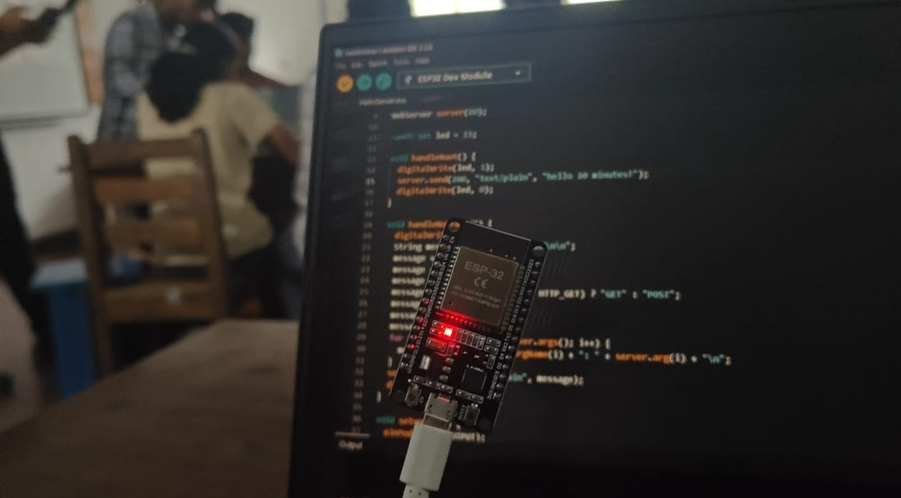
Day
5
The Magic of ESP32 & Web Servers 🌐
What we learned
Introduction to ESP32, a powerful microcontroller with Wi-Fi capabilities.
Understanding the concepts of web servers and how they work.
How to host a webpage using ESP32.

Slide 12
Day
5
The Magic of ESP32 & Web Servers 🌐
Activities & Highlights
📶First ESP32 activity: Blinking a light.
🧠Used AI to help design a cool webpage.
🌐Presented our animated webpage hosted on the ESP32.

Slide 13
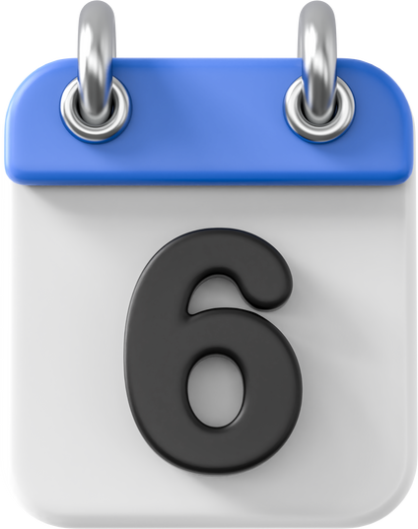
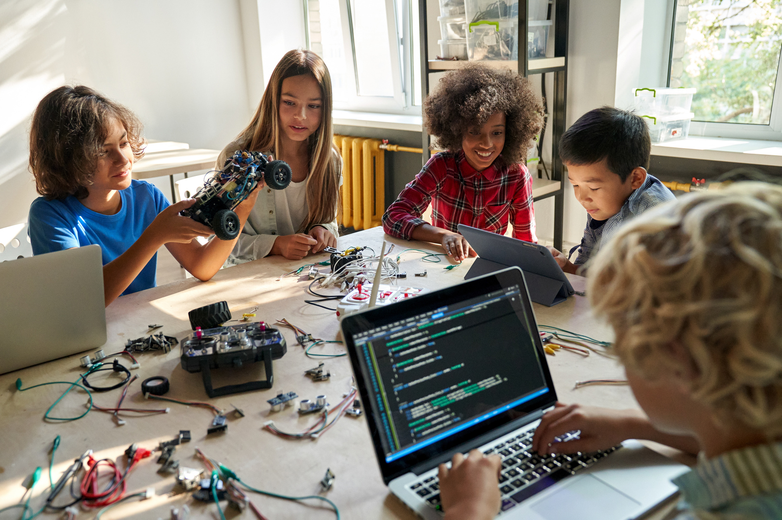
Day
Deep Dive into PID Control
What we Learned
Full explanation of Proportional-Integral-Derivative (PID) control.
How PID logic creates highly efficient and stable systems.
Tuning PID values for optimal robot performance.

Slide 14
Day
Deep Dive into PID Control
Activities & Highlights
📈Built a PID line-following bot.
🧠Gained a deep understanding of control theory.
🏅Kahoot quiz.

Slide 15
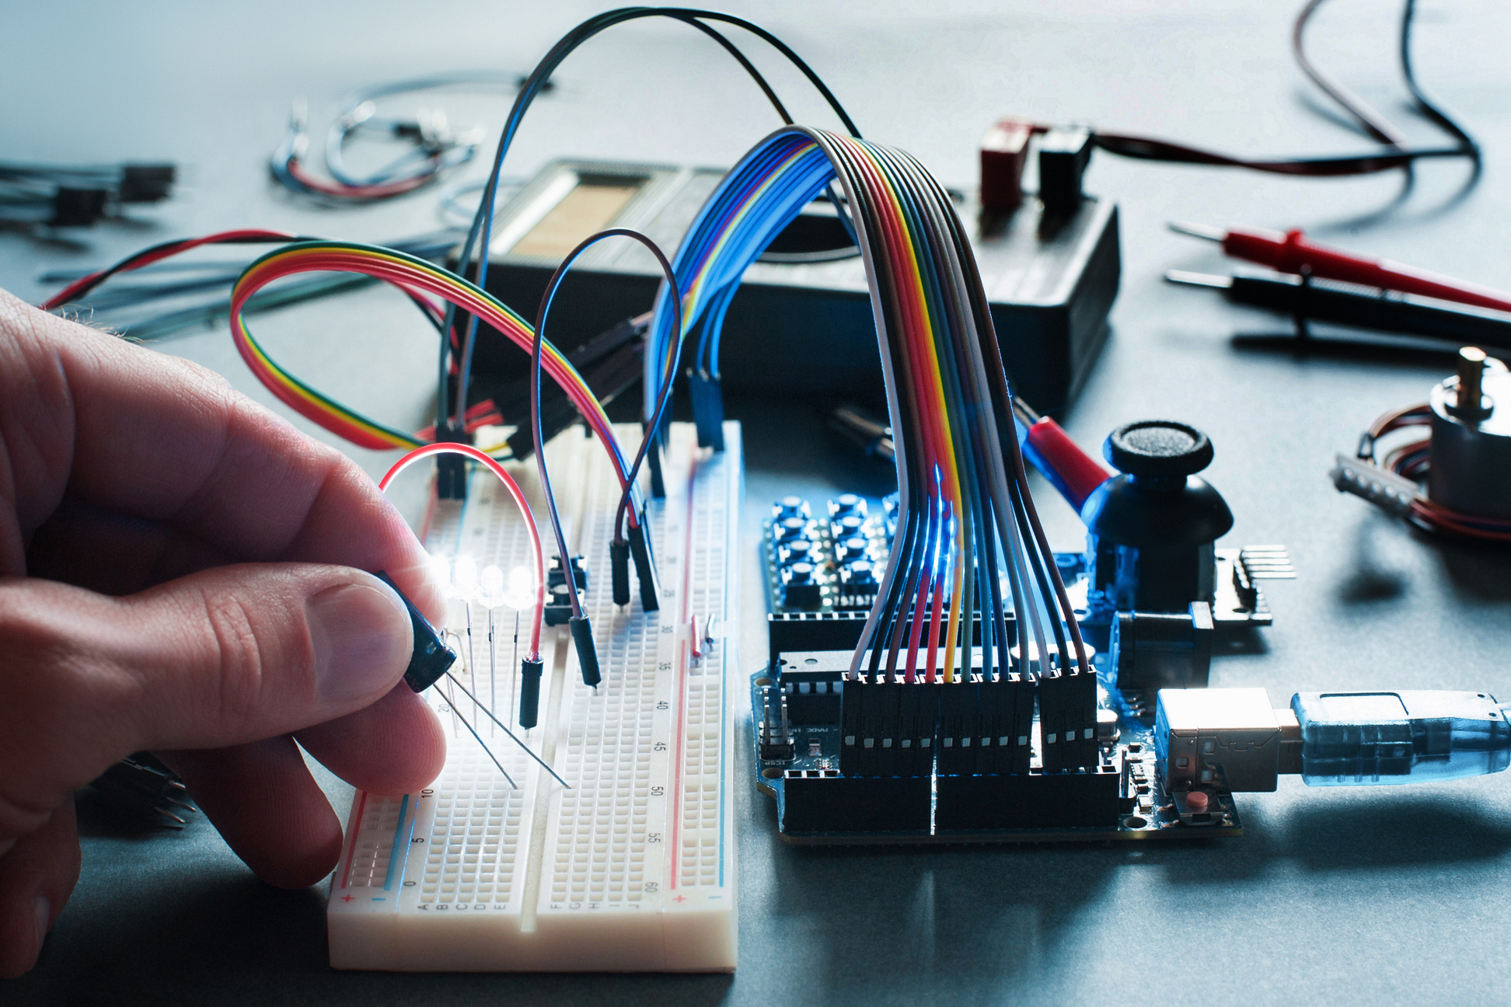
Key Learnings & Skill Development 🧠
Technical Skills:
Basic electronics components and circuit analysis.
Microcontroller programming (Arduino Nano, ESP32).
Sensor integration and motor control.
PID Control implementation for precision.
Soft Skills:
Teamwork: Collaborating effectively on projects.
Presentation Skills: Public speaking (Pick and Speech, Webpage presentation).
Adaptability: Quickly learning new concepts and tools (like AI for webpage design!).

Slide 16
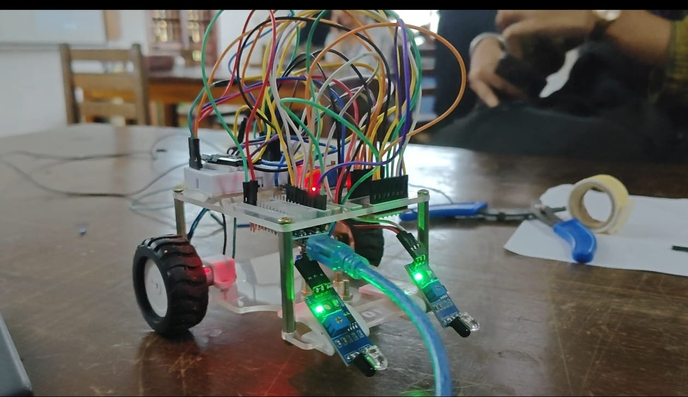
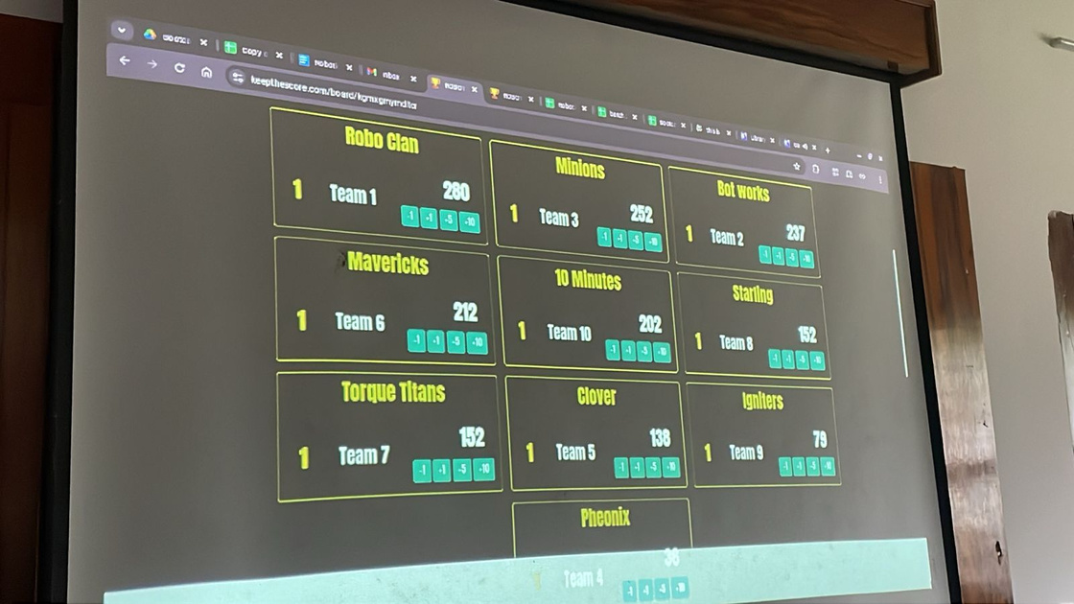
Memorable Moments & Enjoyment 🎉
Bot Races: The thrill of competition and seeing our hard work pay off.
Kahoot Quizzes: A fun and engaging way to review learning each day.
Presenting our AI-generated webpage hosted on ESP32 – a true highlight!
Leadboard: From 10 to 5th place

Slide 17

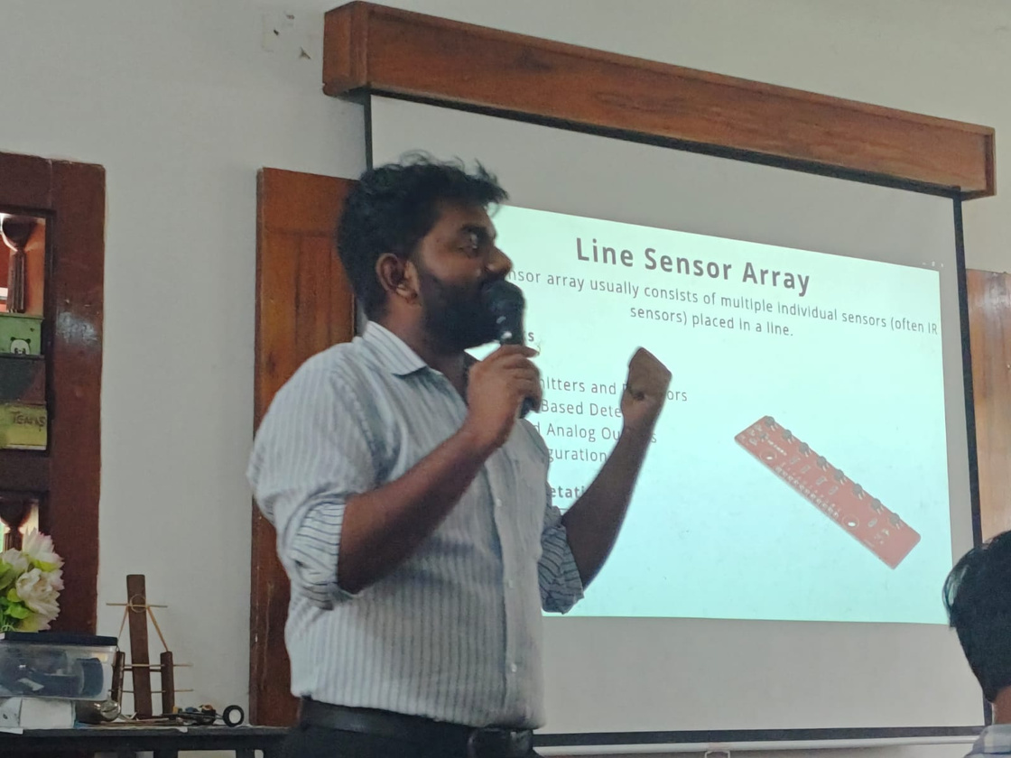
Conclusion
Bootcamp was an amazing and unforgettable journey.
Learned many new skills with hands-on practice.
Enjoyed every moments
Thanks to sir for guidance & support.

Slide 18



“Learning by Doing is the Best Way to Learn”
Team 10 Minutes

